Slide 1
English language

Slide 2
Reflective writing
What is reflective writing? Writing reflectively involves critically analysing an experience, recording how it has impacted you and what you plan to do with your new knowledge. It can help you to reflect on a deeper level as the act of getting something down on paper often helps people to think an experience through.

Slide 3
What is reflective writing? Writing reflectively involves critically analysing an experience, recording how it has impacted you and what you plan to do with your new knowledge. It can help you to reflect on a deeper level as the act of getting something down on paper often helps people to think an experience through.

Slide 4
What are the advantages of reflective learning?
Reflective learning forces you to consider your mistakes, the factors that led to the mistake, and what you could have done differently. This will help you to avoid making that mistake again and means you can truly learn from it

Slide 5
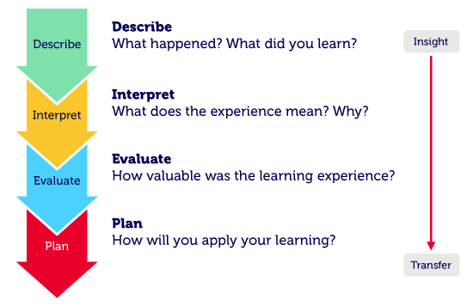

Slide 6


Slide 7


Slide 8
Dialect language
A dialect is sometimes viewed as a subset or ‘type’ of a particular language. It is broadly defined as “a version of a language spoken in a particular geographical area or by a particular group of people.” If the broader language is the parent, then the dialect is the child

Slide 9
Standard English
Standard English. Standard English is the form of English widely recognized and accepted as 'correct'. It is often used in formal situations (e.g. in an exam) and when we are being polite
(e.g. speaking to your headteacher).

Slide 10
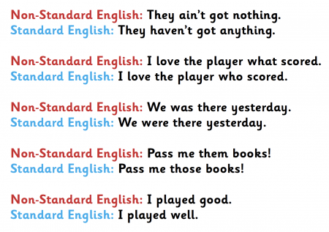

Slide 11
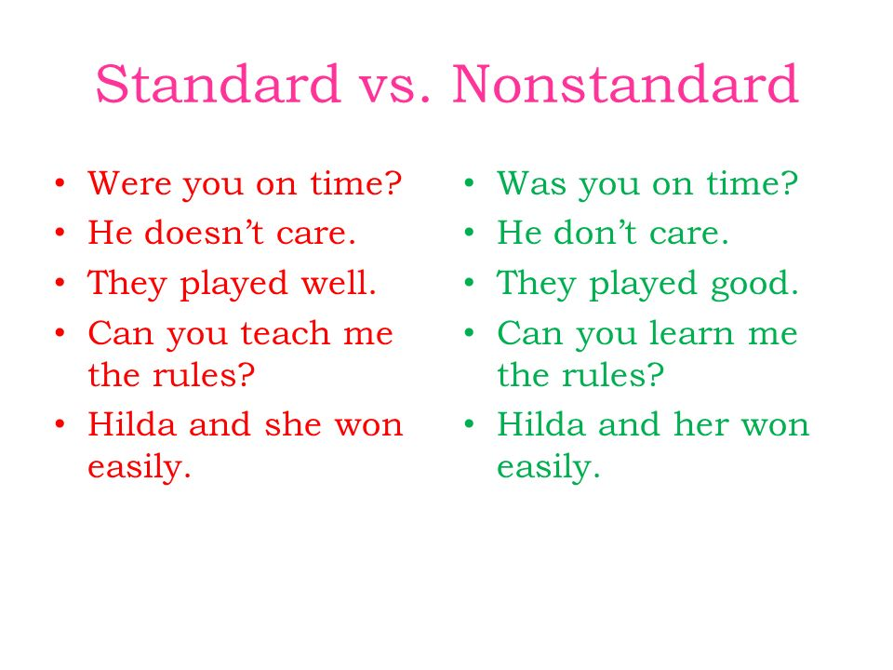

Slide 12
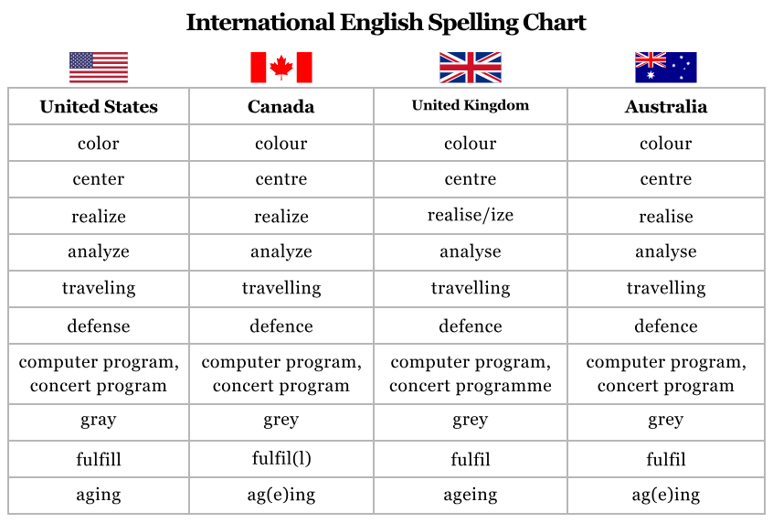

Slide 13


