Slide 1
English language LS
Media Literacy

Slide 2
What is Media
Media literacy is the ability to identify different types of media and understand the messages they're sending.
Media use helps young people become more competent in a digital age. Additionally, media allows for children and young people to express themselves and connect with others who are like them.
Not to mention the ability to foster relationships with family members and friends that may not live locally. And in the wake of the COVID pandemic, we’ve learned so much about how children learn and how we can best harness technology in educational settings.

Slide 3
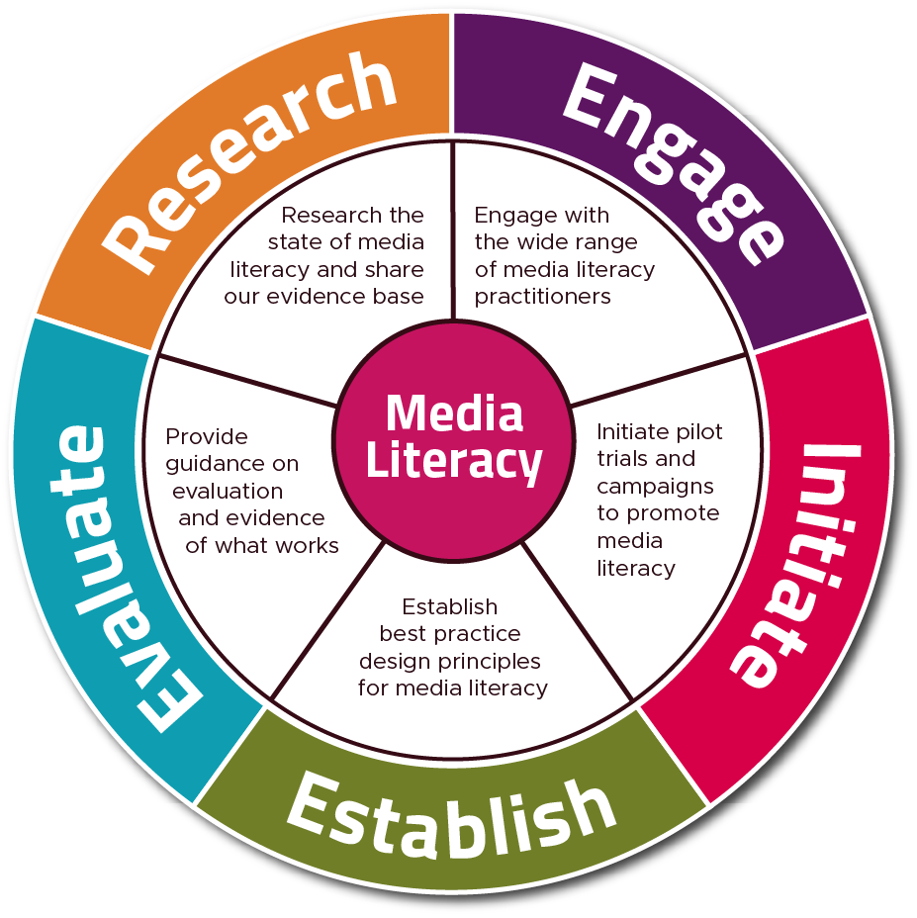

Slide 4
Communication process
Encoding
Medium of transmission
Decoding
Feedback

Slide 5
Purpose of the Media
They educate, inform and entertain through news, features and analysis in the press. They also produce documentaries, dramas, current affairs programmes, public service announcements, magazine programmes and other forms of programming for radio and television.

Slide 6
Main purpose of mass media
The key function of mass media is to communicate various messages through television, movies, advertising, radio, the internet, magazines, and newspapers.
Surveillance, correlation, cultural transmission, and entertainment.

Slide 7
Types of media
Print media: Print media refers to printed materials, such as books and magazines, that contain words and images.
Broadcast media: Broadcast media includes information transmitted through one of several mass communication channels, such as television and radio.
Internet media: Internet media is content distributed online and can include emails and online publications.
Out-of-home media: Out-of-home media, or OOH, is media that reaches people when they are outside of their homes, like billboards.

Slide 8
What is Mass Communication
Mass Communication refers to the process of disseminating and exchanging information through diverse media platforms to reach the masses. Mass Communication is different from Mass Media because various forms of mass media like TV, Radio, the Internet, Print Media, Outdoor Media, etc. are used to facilitate mass communication, i.e. communicate certain information to the masses. These are also different tools of mass communication, that help communicate to a larger audience.

Slide 9
Mass media
Journalism
Social Media
Films
Television
Radio
Advertising
Public Relations
Books, Magazines, Newspapers and Journals
Photography

Slide 10
Functions of media
The general public is significantly impacted by mass media, whether it be in written, spoken, or broadcast form. Brands may raise their profile via social media, TV commercials, and outdoor advertising. Regarding branding, businesses look for the best platforms to communicate their message, including websites, social media platforms, blogs, and forums. These are some of the tools of mass communication. They may express their ideas and run branding campaigns after they choose the best kind of mass media outlet for their companies.

Slide 11
Characteristics of media
A large target audience may find it appealing; a public message is sent; there is a gap between the source of the information and the people who receive it;
It may be broadcast by a variety of media, including television, the Internet, radio, and newspapers;
It draws a diverse audience;
Television, radio, and print media cannot provide comments on news or information that has been distributed.

Slide 12
Advantages of media
Making Space for the Voice of Less Privileged
Mass media plays an essential role in shining the spotlight on the masses as the general public can express their views and opinions freely. This way, it becomes the voice of the voiceless thus giving the right platform for the people to use their right to express themselves freely.
Effective and Wider Communication
It is through different types of mass media from social media to digital platforms that the world has transformed into a global village. This way, mass communication has become useful for people, businesses, governments and the whole world to stay connected with each other.

Slide 13
Diffusion of Diverse Cultures
Mass media also plays a colossal part in spreading arts and cultures to every nook and corner of the world. With the help of the internet, anyone can learn a new language, know about a different culture or even travel the whole world without physically going from one place to another.
Encyclopedia of Information
The internet is truly a massive open source of information and different types of mass media from search engine platforms to social media platforms and learning websites play a greater role in helping anyone learn anything anywhere.

Slide 14
Forms of Traditional Media
Folk Dances
Folk Songs and Music
Theatre, Drama, and Folktales
Painting, Sculptures, Inscriptions, Statues, and Stupas
Motifs and Symbols

Slide 15
Print media
Newspapers (broadsheet and tabloid)
Periodicals, Newsletters, and Magazines (general or specific interest)
Brochures, Leaflets and Pamphlets
Journals

Slide 16
Forms of Broadcasting Media
Television
Radio (AM, FM, Pirate Radio, Terrestrial Radio, and Satellite)
Traditional Telephone
Film/Movie/Motion Picture
Video Games
Audio Recording and Reproduction

Slide 17
Forms of Outdoor Media
Billboards or Bulletins
Inflatable Billboards
Mobile Billboards
Banner
Lamppost Banners

Slide 18
Transit Media
Transit Media revolves around the concept of advertising and information dissemination when consumers are “on the go” in public places or transit.
Bus Advertising
Railway Advertising
Taxi Advertising
Transit Shelter Advertising

Slide 19
Forms of Digital Media
Websites
Emails
Social Media and Social Networking Sites (SNS)
Webcast and Podcast
Blogging and Vlogging
IPTV (Internet Protocol Television

