Slide 1
English Language
Clauses

Slide 2
What is a clause
A clause is “a group of words containing a subject and predicate and functioning as a member of a complex or compound sentence.
It contains only one subject and one verb. The subject of a clause can be mentioned or hidden, but the verb must be apparent and distinguishable.

Slide 3
Independent clause
It functions on its own to make a meaningful sentence and looks much like a regular sentence.
In a sentence two independent clauses can be connected by the coordinators: and, but, so, or, nor, for*, yet*
Example:
He is a wise man.

Slide 4
Dependent clause
It cannot function on its own because it leaves an idea or thought unfinished. It is also called a subordinate clause. These help the independent clauses complete the sentence. Alone, it cannot form a complete sentence.
The subordinators do the work of connecting the dependent clause to another clause to complete the sentence. In each of the dependent clauses, the first word is a subordinator. Subordinators include relative pronouns, subordinating conjunctions, and noun clause markers.
Example:
When I was dating Daina, I had an accident.

Slide 5
Adjective
It is a Dependent Clause that modifies a Noun. Basically, Adjective Clauses have similar qualities as Adjectives that are of modifying Nouns and hence the name, Adjective Clause. These are also called Relative Clauses and they usually sit right after the Nouns they modify.
Example; I’m looking for the red book that went missing last week.

Slide 6
Noun clause
Dependent Clauses acting as Nouns in sentences are called Noun Clauses or Nominal Clauses. These often start with “how,” “that,” other WH-words (What, Who, Where, When, Why, Which, Whose and Whom), if, whether etc.
Examples:
I like what I hear.

Slide 7
Adverbial clause
By definition, these are Dependent Clauses acting as Adverbs. It means that these clauses have the power to modify Verbs, Adjectives and other Adverbs.
Examples:
Alice did the dishes till her legs gave up.

Slide 8
Principal clause
hese have a Subject (Noun/Pronoun), Finite Verb and an Object and make full sentences that can stand alone or act as the main part of any Complex or Compound Sentence. Independent and Principal Clauses are functionally the same but named from different perspectives.
Examples:
I know that boy.

Slide 9
Non finite clause
They contain a Participle or an Infinitive Verb that makes the Subject and Verb evident even though hidden. In terms of a Participle, the Participial Phrase takes place of the Subject or Object of the sentence.
Examples:
He saw the boy (who was) staring out of the window.

Slide 10
Practice: identify if there are IC or DC
I went to the park ID
Sandra and Lara have been good friends since first grade. ID
Although Shaina likes Mexican, Iraqi, Somali, and Italian food DC
After swimming in the ocean DC
Animal communication is not considered to be a legitimate language by some scientists. ID
When Jim and Ayman eat lunch together in the breakroom DC

Slide 11
Join the clauses to make a sentences
When I went to the zoo + I looked at the animals.
  When I went to the zoo I looked at the animals.
He came to class + He forgot his homework.
  He came to class and forget his homework.
We studied all night + Therefore, we did well on the test.
  We did well on the test because we studied all night.
She might have been sick + Maybe her car broke down.
  She might have been sick or her car broke down.
They went out to eat + Because they were hungry.
  They were hungry so they went out to eat.

Slide 12
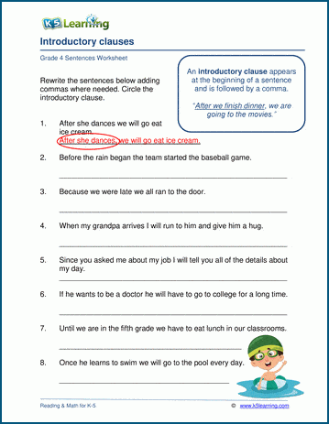

Slide 13
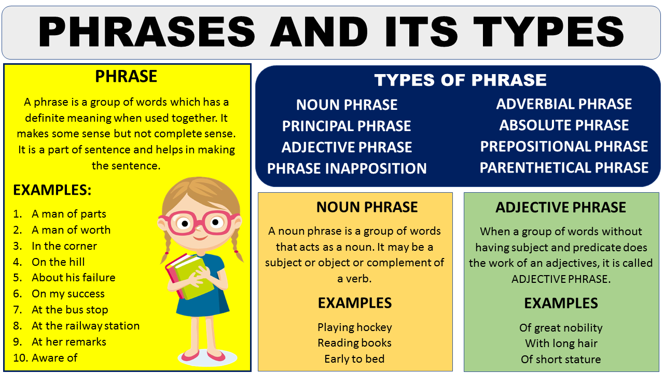

Slide 14
