Slide 1
English Language
Present tense

Slide 2
What is present tense
The present tense is the verb form you use when you talk about what's happening right now.
"You are standing on my foot" is in the present tense.

Slide 3
Types of present tense
Simple Present Tense.
Present Continuous Tense.
Present Perfect Tense.
Present Perfect Continuous Tense

Slide 4
Simple Present tense
The simple present is a verb tense with two main uses. We use the simple present tense when an action is happening right now, or when it happens regularly (or unceasingly, which is why it’s sometimes called present indefinite).
Example; Pauline loves pie.
Pauline practices the piano every day.

Slide 5
Present continuous tense
Used to denote an action that is continuing at the present moment.
It is also referred to as the present progressive tense as they represent the action that is progressing in the present
Example; The baby is crying out loud.

Slide 6
Rules for present continuous
Always start with the subject when it is a positive or negative sentence and with the helping verb when it is in the interrogative format.
A sentence with the present continuous tense consists of a helping verb (‘to be’ form of verbs) and a main verb. The helping verbs can be ‘am’ for the pronoun ‘I’, ‘is’ for singular subject and ‘are’ for a plural subject.
Just note that like the other pronouns, the pronoun ‘am’ cannot be used in the negative form in an interrogative sentence. Instead of ‘amn’t’, ‘aren’t’ is used.

Slide 7
Present perfect tense
The present perfect tense is a tense used in present to indicate the action that has taken place at some specific time. It uses auxiliary verb and past participle for the main verb i.e. verb + ed.
Examples of present perfect tense are – I have watched this movie before, He has completed his homework.

Slide 8
Examples
I have written articles on different topics.
He has read various kinds of books.
They have played football.

Slide 9
Present perfect continuous
The present perfect continuous tense, on the other hand, is used to depict an action or event that started in the recent past and is still continuing at the time when the speaker is referring to it.
For example: Preethi has worked as an English teacher for two years.

Slide 10
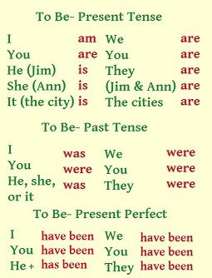

Slide 11
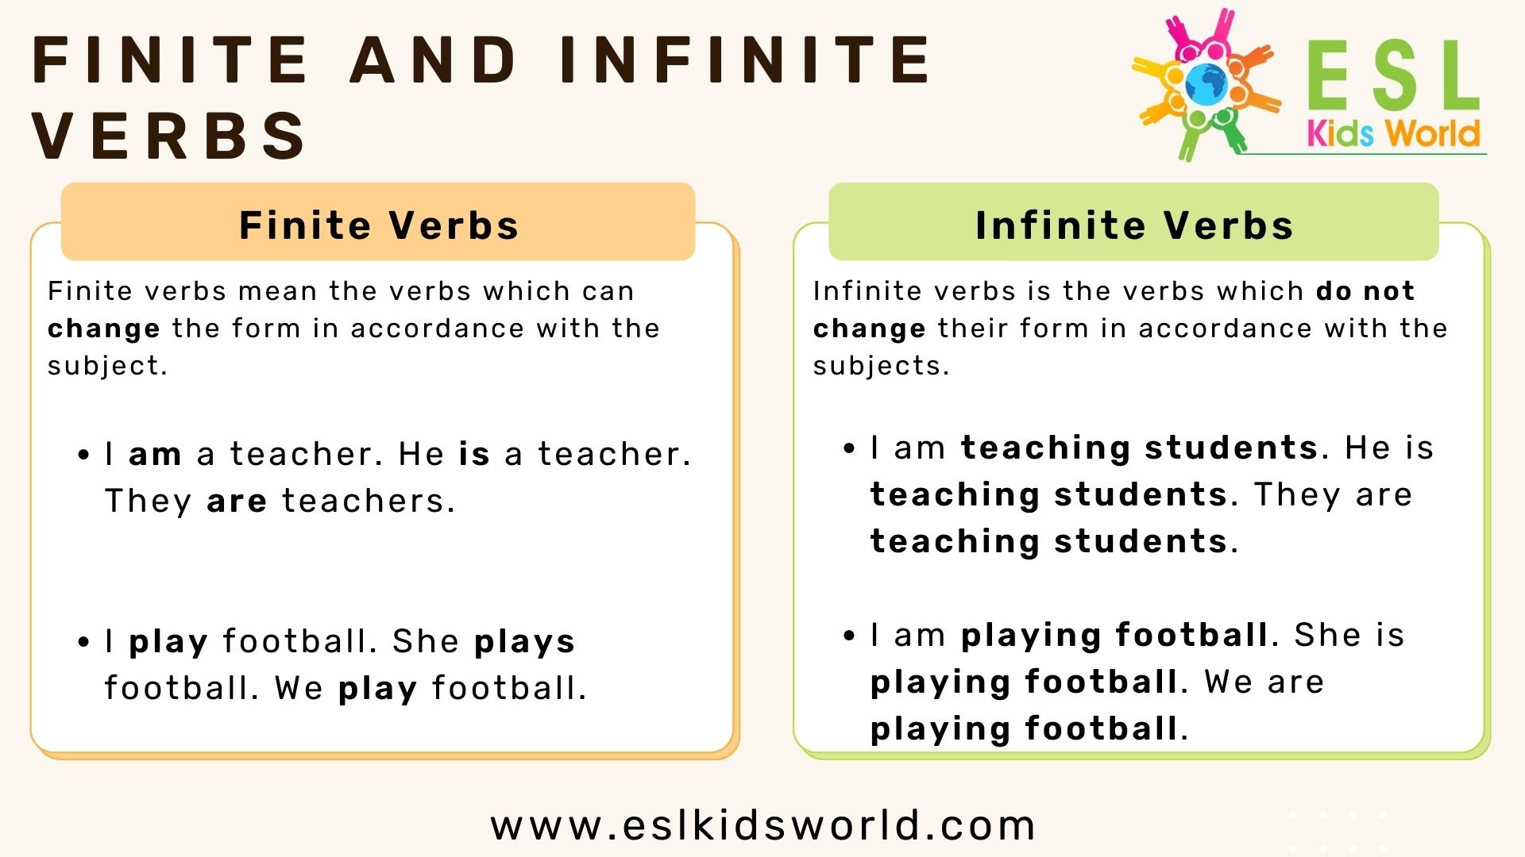

Slide 12


