Slide 1
English LS
Comparing adjectives
Main idea
Inference

Slide 2
Adjectives
An adjective is a word that modifies or describes a noun or pronoun. Adjectives can be used to describe the qualities of someone or something independently or in comparison to something else.
I like old houses.
The boy is tall and skinny.

Slide 3
Comparing adjectives
Comparative adjectives are used to compare two things. They’re usually formed by adding the suffix “-er” (or “-r” if the word ends in the letter “e”). For two-syllable words that end in “y,” the “y” is replaced with “-ier.”
Comparative adjectives can also be formed by adding “more” or “less” before an adjective that has not been modified. The “more” form is typically used for words with two or more syllables, while the “less” form is used for all adjectives.

Slide 4
Example
Simon’s essay is longer than Claire’s.
The room is cozier with the fire lit and less cozy without it.

Slide 5
Superlative adjectives
Superlative adjectives are used to indicate that something has the most or least of a specific quality. They’re typically preceded by the definite article “the” and usually formed by adding the suffix “-est” (or “-st” if the word ends in the letter “e”). For two-syllable words that end in “y,” the “y” is replaced with “-iest.”
Superlative adjectives can also be formed by adding “most” or “least” before an adjective that has not been modified. The “most” form is typically used for words with two or more syllables, while the “least” form is used for all adjectives.

Slide 6
Even the greatest athletes need adequate rest.
All the courses were delicious, but the dessert was the tastiest.

Slide 7
Absolute adjective.
An absolute adjective is an adjective describing an absolute state that cannot be compared. For example, the word “dead” is often considered to be an absolute adjective because it’s not possible to be “deader” than someone else.
However, actual usage varies, and absolute adjectives are often modified by words such as “almost.”

Slide 8
Coordinate adjectives
Coordinate adjectives are two or more adjectives that modify the same noun in a sentence. Coordinate adjectives can be separated by commas or by the conjunction “and.”
Examples: Coordinate adjectives in a sentence The plums were cool and delicious.

Slide 9
Main idea
Helps in comprehension

Slide 10
What is the main idea
A main, or central, idea is the most important idea or claim that a text conveys. The supporting details provide information that develops the main idea. Each detail in a text plays a specific role in supporting or refining readers' understanding of the main idea.
A general statement about the paragraph (or reading selection). The main idea is a sentence that provides the subject for discussion; it is the topic sentence. It is usually supported by a list of details. If you can tell what the supporting details have in common, you can discover the main idea.

Slide 11
Supporting details
Supporting details are information, details, or points of discussion that prove the main idea. The bulk of any piece of writing is made up of these supporting details. In fiction writing, supporting details include the characters, plot details, and setting details. In non-fiction, supporting details can take many different forms such as statistics, examples, history, or logical analysis, among many others. They all are included to help the reader establish a clear understanding of the main idea.

Slide 12
Example
An example of main idea can be found in the classic story of Romeo and Juliet by William Shakespeare. The story is about two young kids who fall in love, but their families are bitter enemies. The main idea of Romeo and Juliet centers around the power of love.
The main idea of a story is the central idea or concept that the author wants to portray through the narrative, characters, and settings. The main idea can either be explicit, which means it's directly stated in the story, or it can be implied, which means it's not directly stated in the story. It's important not to confuse the main idea with the main topic or the central theme of a story.

Slide 13
Finding the main idea.
Identify the Topic. Read the passage through completely, then try to identify the topic
Summarize the Passage. After reading the passage thoroughly, summarize it in your own words in one sentence
Look at the First and Last Sentences of the Passage
Look for Repetition of Ideas

Slide 14
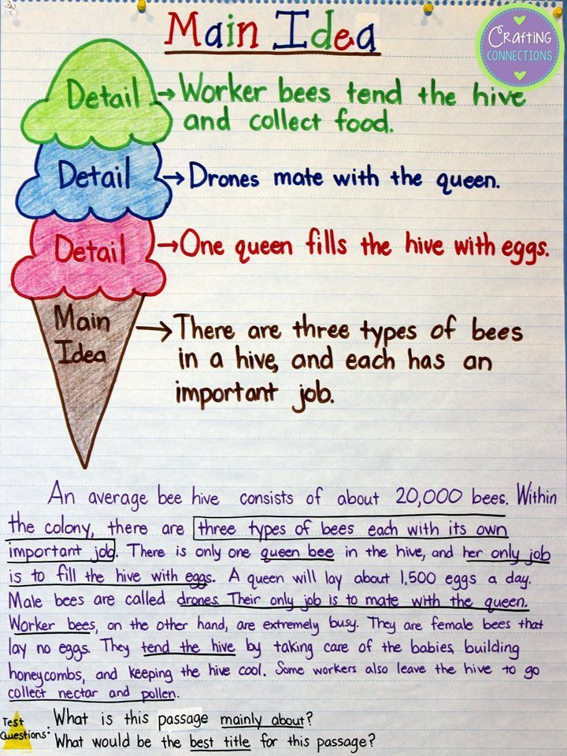

Slide 15
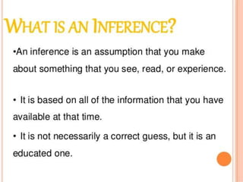

Slide 16
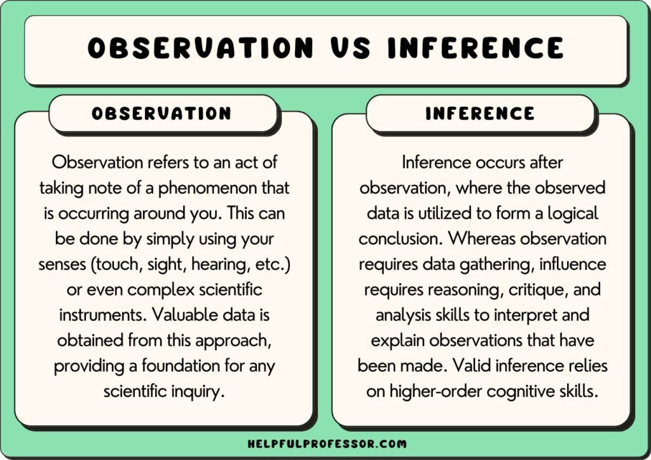

Slide 17
Inferences
When writing an essay, you might need to make inferences about your sources. Authors do not always directly say what they mean. Sometimes they use clues to help the reader come to their own conclusions.

Slide 18
Inference from context
You can infer meaning from the context of a source. Context is the stuff surrounding a text, like the time, location, and other influences.
To determine context, you can look at:
Setting (time and/or place it was written)
Situation the author is responding to (an event, issue, or problem influencing the source)

Slide 19
Inference from tone
You can infer what an author means by looking at their tone. The tone is the attitude an author takes when writing.
To determine tone, you can look at:
Descriptive words in the source (do the adjectives and adverbs sound sarcastic? Angry? Impassioned?)
Feelings the source brings up (how does the source make you feel? Does the author seem to intend you to feel that way?)

Slide 20
Inference from examples
You can look for an author's meaning in their examples. Sometimes the examples an author uses show things the author doesn't know how to say.
To infer from examples, you can ask yourself:
Why did the author choose these examples?
What feelings does this example give me?
What can we learn from these examples that the author does not directly state?

Slide 21
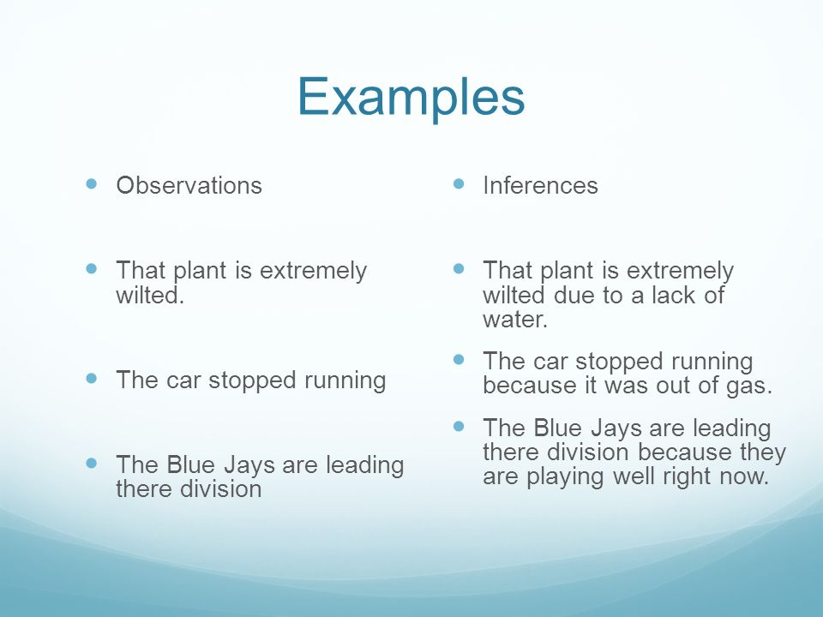

Slide 22
