Slide 1
English Lower Secondary
Main Idea and context clues

Slide 2
What are context clues
Context clues are hints found within a sentence, paragraph, or passage that a reader can use to understand the meanings of new or unfamiliar words.
Learning the meaning of a word through its use in a sentence or paragraph is the most practical way to build vocabulary, since a dictionary is not always available when a reader encounters an unknown word.

Slide 3
SYNONYM RESTATEMENT CLUE
The reader may discover the meaning of an unknown word because it repeats an idea expressed in familiar words nearby. Synonyms are words with the same meaning.
a. Flooded with spotlights – the focus of all attention – the new Miss America began her year-long reign. She was the cynosure of all eyes for the rest of the evening.
“Cynosure” means “the focus of all attention.”

Slide 4
b. The mountain pass was a tortuous road, winding and twisting like a snake around the trees of the mountainside.
“Tortuous” means “winding and twisting

Slide 5
CONTRAST / ANTONYM CLUE
Antonyms are words with opposite meanings. An opposite meaning context clue contrasts the meaning of an unfamiliar word with the meaning of a familiar term. Words like “although,” “however,” and “but” may signal contrast clues.
When the light brightens, the pupils of the eyes contract; however, when it grows darker, they dilate.
“Dilate” means the opposite of “contract.

Slide 6
MOOD / TONE CLUE
The author sets a mood, and the meaning of the unknown word must harmonize with the mood.
Examples: The lugubrious wails of the gypsies matched the dreary whistling of the wind in the all but-deserted cemetery.
“Lugubrious,” which means “sorrowful,” fits into the mood set by the words “wails,” “dreary,” and “deserted cemetery.”

Slide 7
ANALYSIS OR STRUCTURE CLUE
The parts used to construct a word can be direct clues to meaning. Knowledge of prefixes, roots, and suffixes can aid a reader in using this type of context clue. Learning one word part can add dozens of words to a reader’s vocabulary. The power of word parts lies in the ability to combine the roots and affixes with the context in which a word is used to discover the author’s meaning.
Examples:
The story is incredible.
The root cred means “to believe,’ and the prefix in means “not.” Therefore, if a story is incredible, it is unbelievable.
The somnambulist had to be locked in his bedroom at night for his own safety.
The meaning of ambular (walk) and somn (sleep) and sees the sentence, the meaning of “somnambulist” is a sleepwalker.

Slide 8
INFERENCE CLUE
Sufficient clues might be available for the careful reader to make an educated guess at the meaning
Example:
She told her friend, “I’m through with blind dates forever. What a dull evening! I was bored every minute. The conversation was absolutely vapid.”
“Vapid” means “uninteresting..

Slide 9
CAUSE AND EFFECT CLUES
The author explains the reason for or the result of the word. Words like “because,” “since,” “therefore,” “thus,” “so,” etc. may signal context clues.
Example: a. She wanted to impress all her dinner guests with the food she served, so she carefully studied the necessary culinary arts.
“Culinary” means “food preparation.”

Slide 10
ENGLISH CESC
WRITING PROCESS

Slide 11
The Writing Process
Prewriting
Think
Drafting
Write out ideas
Revising/ editing
Look for errors
Editing and publish/submit
This is the final piece
Decide on topic
Brainstorming
Read what you have written
Make changes.
Read over make sure all your ideas are there
Look for spelling and grammar errors.
Make sure all your punctuation marks are there.

Slide 12
Elements of a story
Plot
Tells us the flow of the story
Characters
People involved in the story
Animals involved in the story.
POV
Tells the perspective the story is told from
Setting
The time place and location the story is set in.
Conflict
Tells us the issue in the story.
Style
The way in which the story is written.
The mood, tone and sentence style.

Slide 13
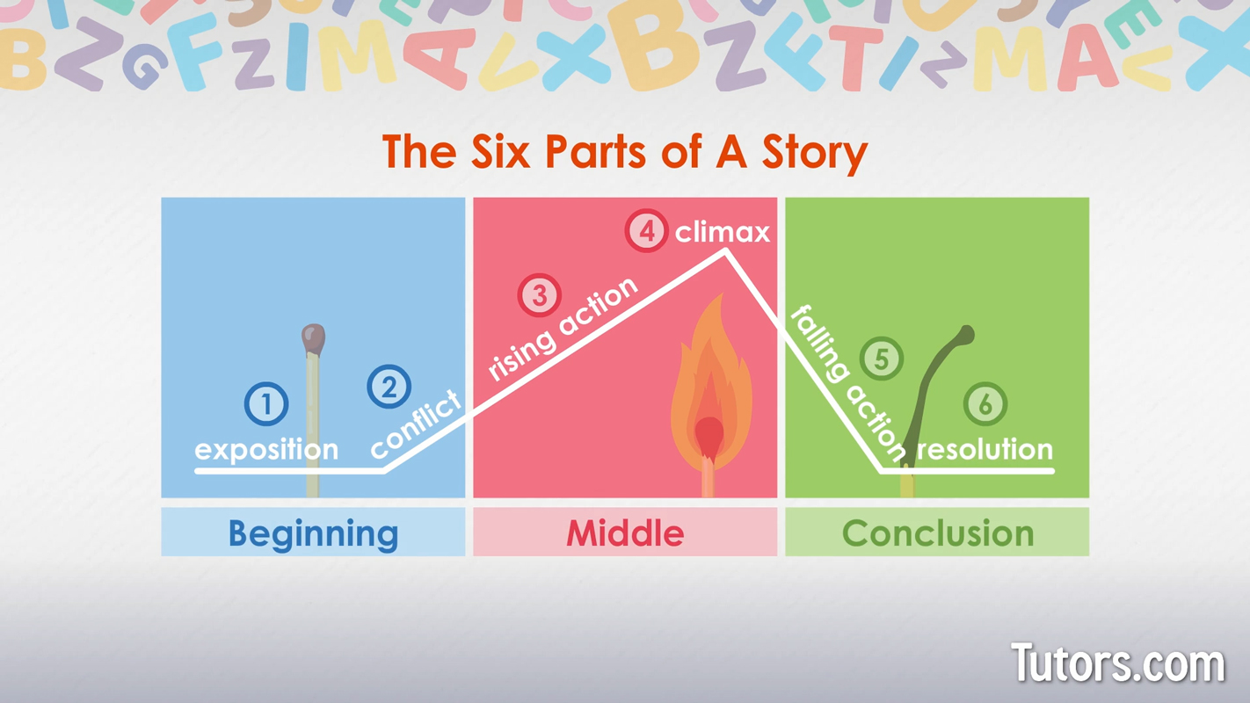

Slide 14
Topic
My Time of Getting in Trouble Because of a Friend.

Slide 15
My Time of Getting in Trouble Because of a Friend.
Getting in Trouble
Who
What
Why
Where
When
How

