Slide 1
English Language
Coordinating Conjunctions and types of sentences

Slide 2
What is a coordinating conjunction.
A coordinating conjunction is a conjunction that connects words, phrases, and clauses that are coordinate, or equal to each other.
There are seven coordinating conjunctions: for, and, nor, but, or, yet, so.
They can be remembered using the acronym FANBOYS.

Slide 3
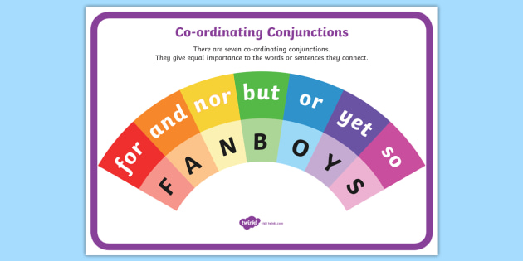
Some of the most useful conjunctions belong to a subset known as coordinating conjunctions. They are the words that create links between words or groups of words.

Slide 4
Here are some examples of FANBOYS in sentences:
Plenty of vegetables were ready to be picked in her garden, so Maria didn’t go to the farmers’ market this week.
Do you like the taste of peaches or mangoes better?
Samir bikes to the park and plays soccer there almost every weekend.

Slide 5
Coordinating conjunctions to join single words
When a coordinating conjunction joins two or more individual words, those words should be the same part of speech: a noun with a noun, a verb with a verb, an adjective with an adjective, and so on. Here are some examples, with the coordinating conjunctions in bold and the words being connected underlined:
Did you remember to bring pen and paper?
Sometimes I shower or bathe at night instead of in the morning.

Slide 6
Coordinating conjunctions to join phrases
Coordinating conjunctions can also link phrases of the same grammatical type.
In the following sentence, the coordinating conjunction and connects two noun phrases:
The antique desk and the modern lamp look surprisingly natural together.
Here’s a sentence in which the coordinating conjunction but connects two prepositional phrases:
I got to the movie before Edam but after Vera.

Slide 7
Compound sentences
A compound sentence joins two or more sentences that have related ideas of equal importance.
The two sentences go together. Each sentence or independent clause must still have a subject and a verb.
For example: She wanted spinach salad; he wanted a hamburger.

Slide 8
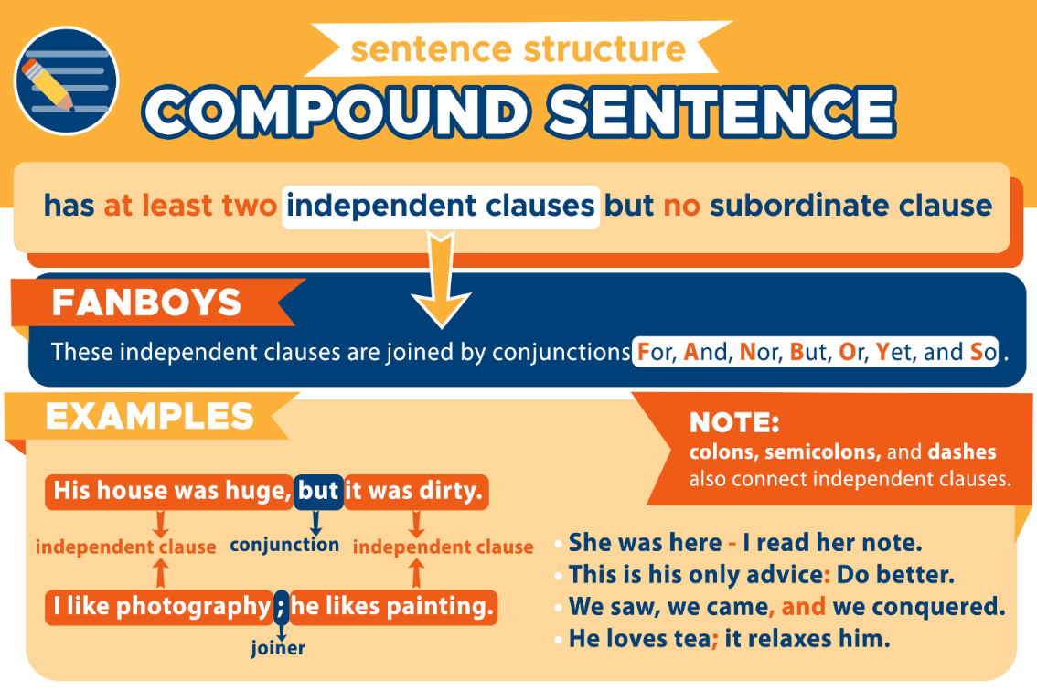
How do you identify a compound sentence
A compound sentence consists of two or more independent clauses joined by a comma and a coordinating conjunction.

Slide 9
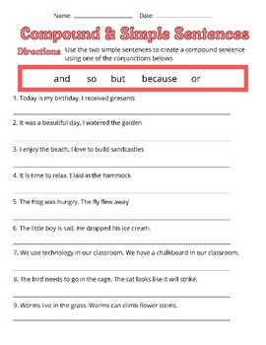

Slide 10
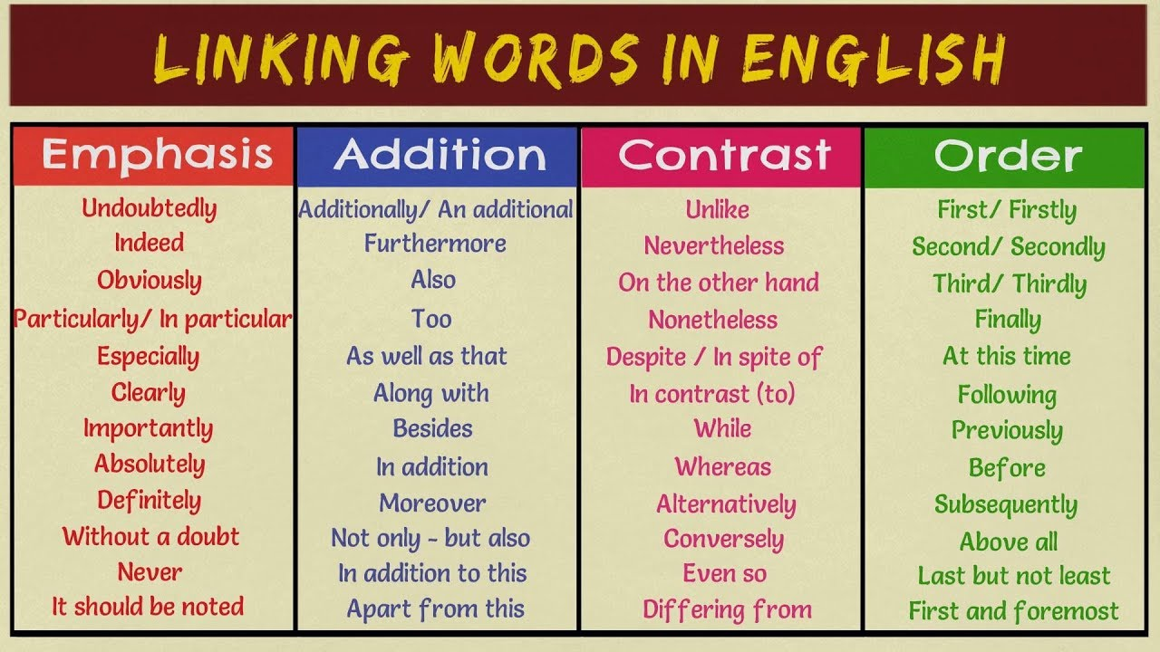

Slide 11
