Slide 1
Agricultural Science
Planting

Slide 2
Land Preparation
Land preparation typically involves ploughing, harrowing, and leveling the field to make it suitable for crop establishment, land preparation releases nutrients to the soil, destroying /reducing weeds and ants nest, it also improves the soil and plant contact and reduces the incidence of pests and diseases infestation.

Slide 3
Importance of land preparations
Protects the land from weeds and pests by reducing the weed competition for light and nutrients. Improves the soil, water, and air conditions to provide an ideal environment for crops to grow. Loosens tight or compacted soils to allow the air to pass through them and allow the soil to breathe.

Slide 4
How do you prepare the land
Remove weeds ( by hoe, weed wacker, brushing cutlass) – Remove undesirable materials.
Do not remove by burning as it destroys the land and the organic soil.

Slide 5
Mechanical land clearing
Some of the procedures for mechanical land clearing are: surveying, knockdown of trees, windrowing, burning and removal of debris, and pioneer ploughing.
Survey helps to determine the size of tractor, the type and size of matched equipment, and the clearing method to be used.

Slide 6
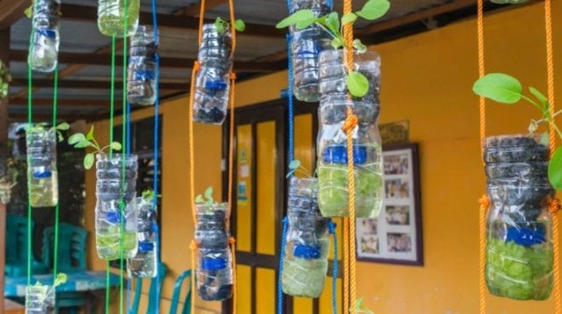
Good environmental practices
Build Your Own Planters
Create a Rainwater Barrel
Mulch Beds to Retain Water
Grow Native Plants
Pull Weeds by Hand
Compost

Slide 7
